Slide 1
Digital Design - 4200529
Juan-Bernardo Gómez-Mendoza
Universidad Nacional de Colombia - Manizales
Dept. of Electric, Electronic and Computing Engineering
2025-1S

Slide 2
Outline
Motivation
Introduction to Digital Design.
Learning Outcomes.
Topics.
Methodology.
Schedule.
Evaluation.
Bibliography.

Slide 3
Motivation
In Hardware Design:
Microprocessor design is a core skill for hardware engineers, particularly those working on processor design, embedded systems, and related fields.
In Software Development:
Even if you're primarily interested in software, understanding how microprocessors work can help you write more efficient and optimized code.
In Emerging Technologies:
With the rise of the Internet of Things (IoT), autonomous vehicles, and artificial intelligence (AI), there's a growing need for engineers who can design and optimize hardware for these applications.

Slide 4
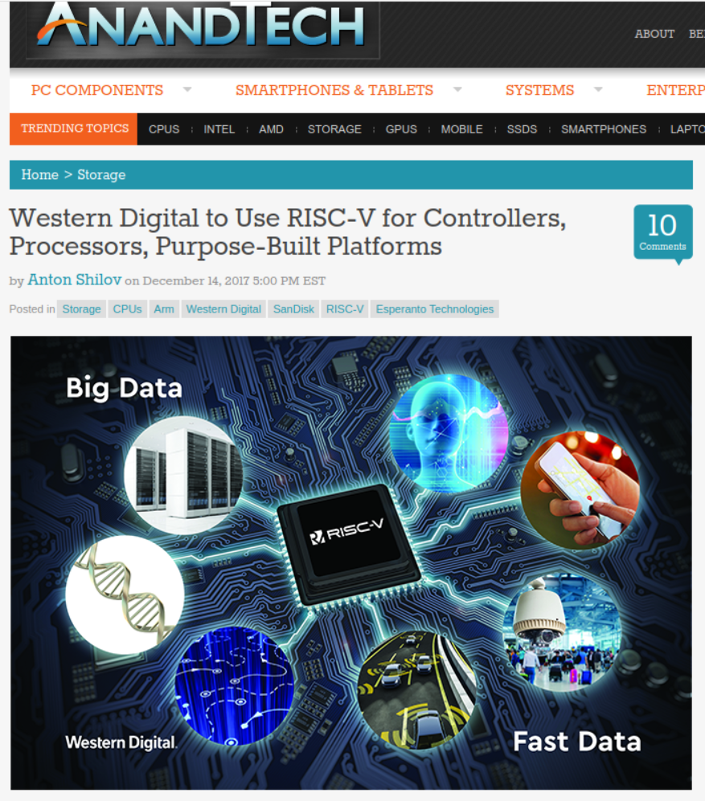
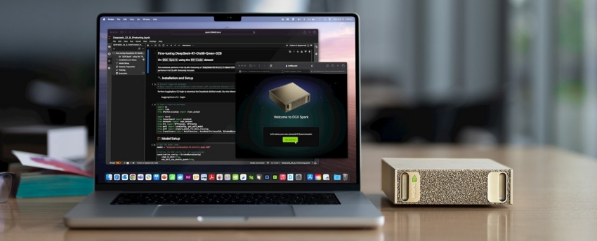
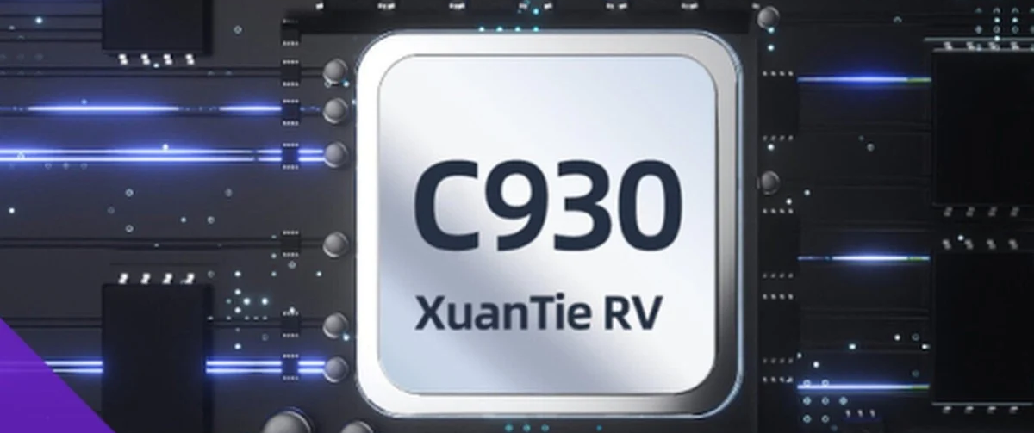
Motivation

Slide 5

Motivation

Slide 6
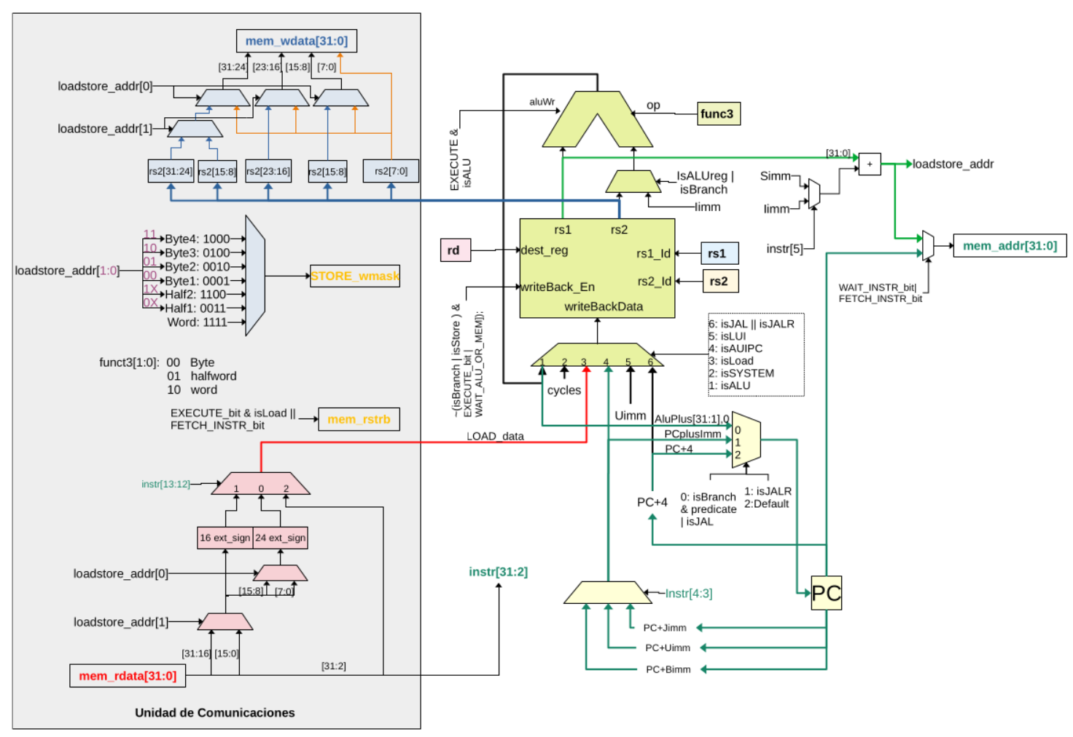
Motivation

Slide 7
Introduction to Digital Design
This course introduces students to digital system design, emphasizing microprocessor architectures and peripheral integration. Students will design and verify combinational and sequential logic circuits using register transfer logic (RTL) methodologies and hardware description languages (Verilog/SystemVerilog).
The course provides practical experience in design, simulation, verification, and on-hardware testing using FPGA platforms. Students will specifically focus on designing and integrating peripheral devices connected to a Wishbone bus of a pre-designed, non-pipelined RISC-V (RV32I) microprocessor core.

Slide 8
Learning Outcomes
Upon successful completion of this course, students will be able to:
Understand and apply register transfer logic (RTL) for digital system design.
Design, simulate, and verify combinational and sequential logic circuits using Verilog and SystemVerilog.
Implement and validate digital designs through FPGA-based hardware simulation and testing.
Explain and analyze fundamental concepts of the RISC-V 32-bit (RV32I) architecture.
Design peripherals compatible with the bus interface for integration with a pre-designed RISC-V core.
Demonstrate teamwork and collaborative skills through the design and verification of integrated digital systems.

Slide 9
Topics
Introduction to Digital Systems and Microprocessor Architectures.
Hardware Description Languages for design and implementation of digital systems.
Combinational and Sequential Logic Design.
Register Transfer Logic.
Microprocessor architecture, datapath, and RISC-V fundamentals.
Peripheral design and bus integration.
Instruction pipelining.

Slide 10
Methodology
Most sessions will have both lecture and lab work.
The use of computer simulation is mandatory, both for design and verification purposes.
Problems assigned as homework should always be accompanied by verification procedures and simulation, unless stated otherwise.
Deliverables are to be presented individually, unless stated otherwise. They are to be submitted via Google Classroom.
Assignments submitted after the due date will be penalized.
EDA Playground is going to be used as main resource for design and simulation. However, the use of free software is encouraged (iverilog, verilator).
Vendor-specific software is going to be used once FPGA-based verification is tackled.

Slide 11
Evaluation
Homework assignments | 40%
Peripheral design: documentation design verification and testing (sim) verification and testing (hw) integration testing | 10% 15% 15% 10% 10%

Slide 12
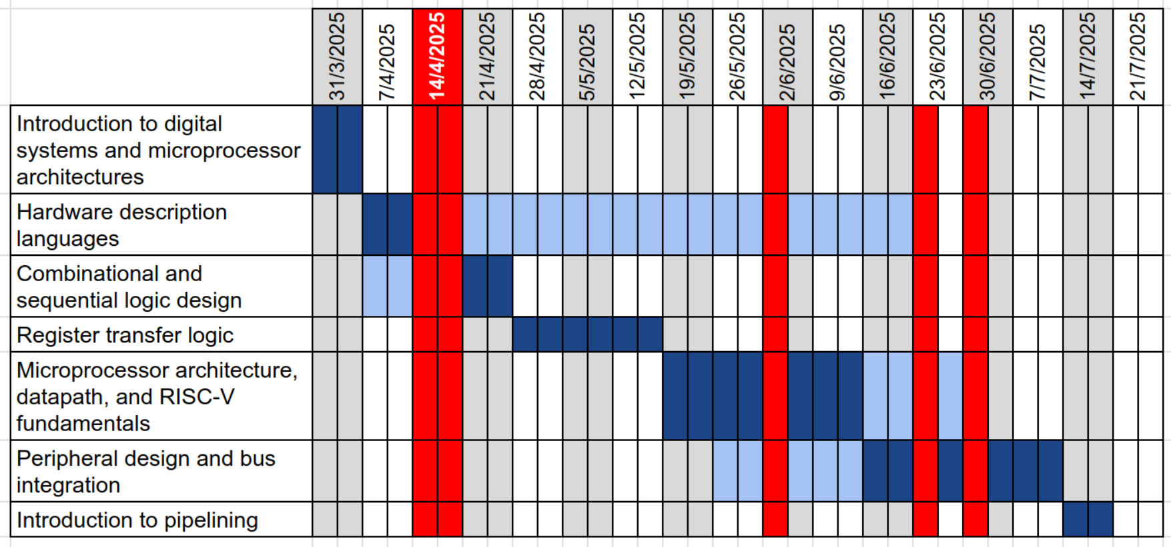
Schedule

Slide 13
Bibliography
Digital Design, with an introduction to the Verilog HDL, VHDL, and SystemVerilog, 6th edition. Morris-Mano, M.; and Ciletti, M.D. Pearson, 2019.
Computer Organization and Design, RISC-V Edition. Patterson, D.A.; and Hennessy, J.L. Morgan Kaufmann Publishers, 2018.
Modern Computer Architecture and Organization, 2nd edition. Ledin, J. Packt, 2022.

